Slide 1
CP5046 Group Presentation
Mouse Dynamics
Analysis
Machine Learning Project · Group 2

Slide 2



Team Charter
Dave
Bhuvi
Hemmy
Nguyen Thanh Binh
Bhuvaneswari Saravanan
Hemanth Kumar
Project Manager
Researcher
Scrum Master

Slide 3
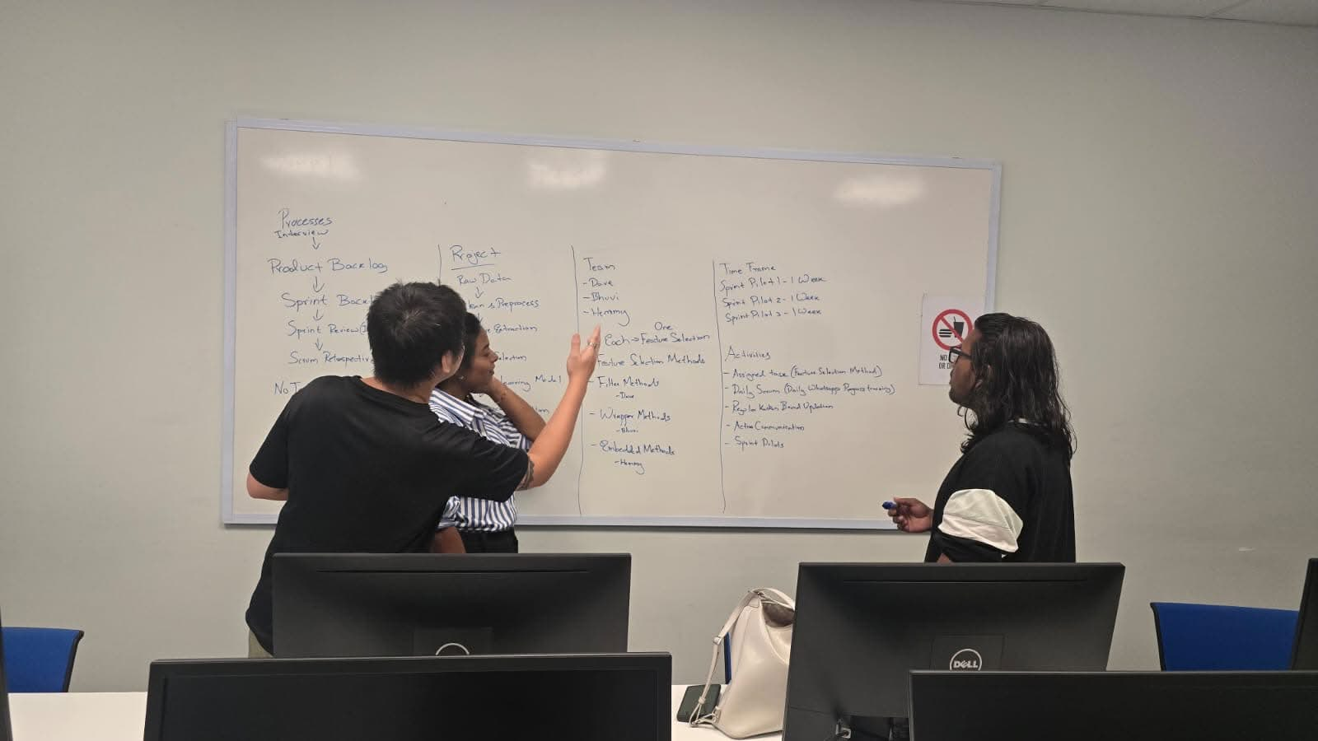
Project Introduction
Mouse Dynamics Analysis
Checks Authenticity Of Users based on Mouse Movement Patterns
🔐
Protect student accounts from unauthorised access non-invasively
🎓
Verify the identity of students attempting assessments
🌐
Data Analysis – Machine Learning

Slide 4
Interviews
Q1
Q2
Q3
Why is there a need for this type of application?
Are the students all healthy or are there any disabled students?
What are the expectations for a general weekly timeframe?
Recent Events
Outliers
Project Requirements

Slide 5
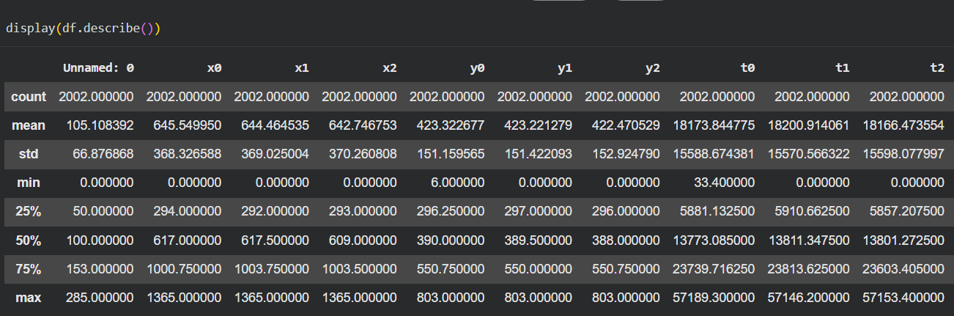
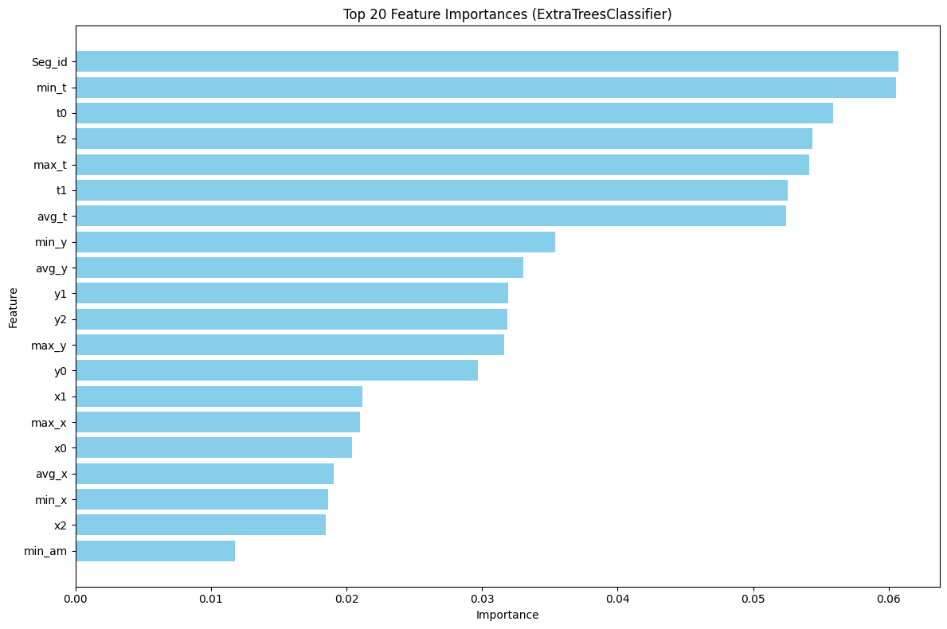
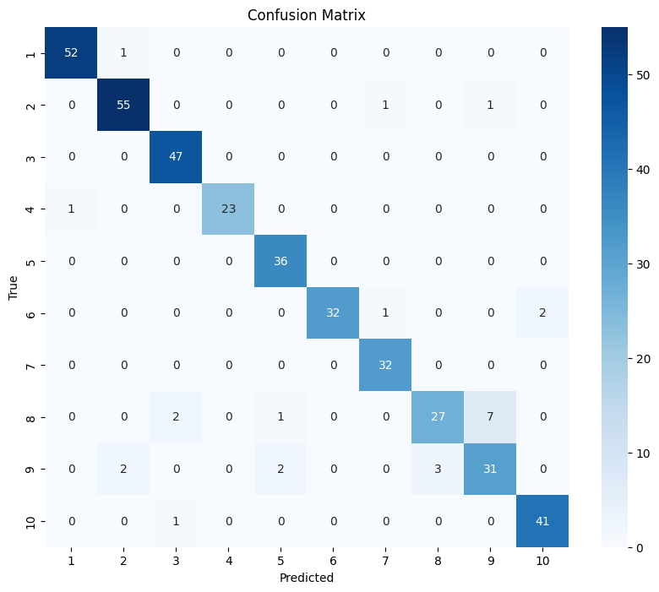
User Stories
1
2
3
Loading Data
Feature Selection
Visualization of Feature Set
As a data team member, I want to load and visualize student mouse movement data so that I can confirm the data is usable.
As a security team member, I want to see which mouse behaviors are unique enough to tell students apart.
As a management team member, I want an organized table of student mouse behavior measurements for governance.

Slide 6
Product Backlog
ID
Backlog Item
Priority
Sprint
Status
PB-01
Data Loading
Must
1
Done
PB-02
Feature Selection
Must
2
Done
PB-03
Visualization (Analysis)
Must
3
Done
Kanban Board Activities : https://www.figma.com/board/83IxzxWTGTgGQOvhXNQeAf/2026-TR2-ICT1-Group2?node-id=7-9760&t=EnZKeE4VFpgojbMP-0

Slide 7
Sprint Backlog
Dave
Bhuvi
Hemmy
Feature Evaluation Set 2
Feature Evaluation Set 3
Loading Data
Visualization
Visualization
Feature Evaluation Set 1
Visualization

Slide 8
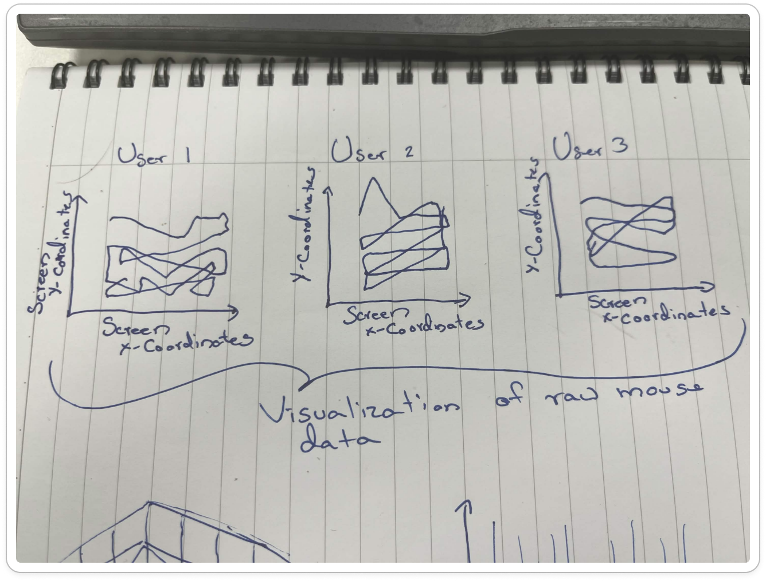
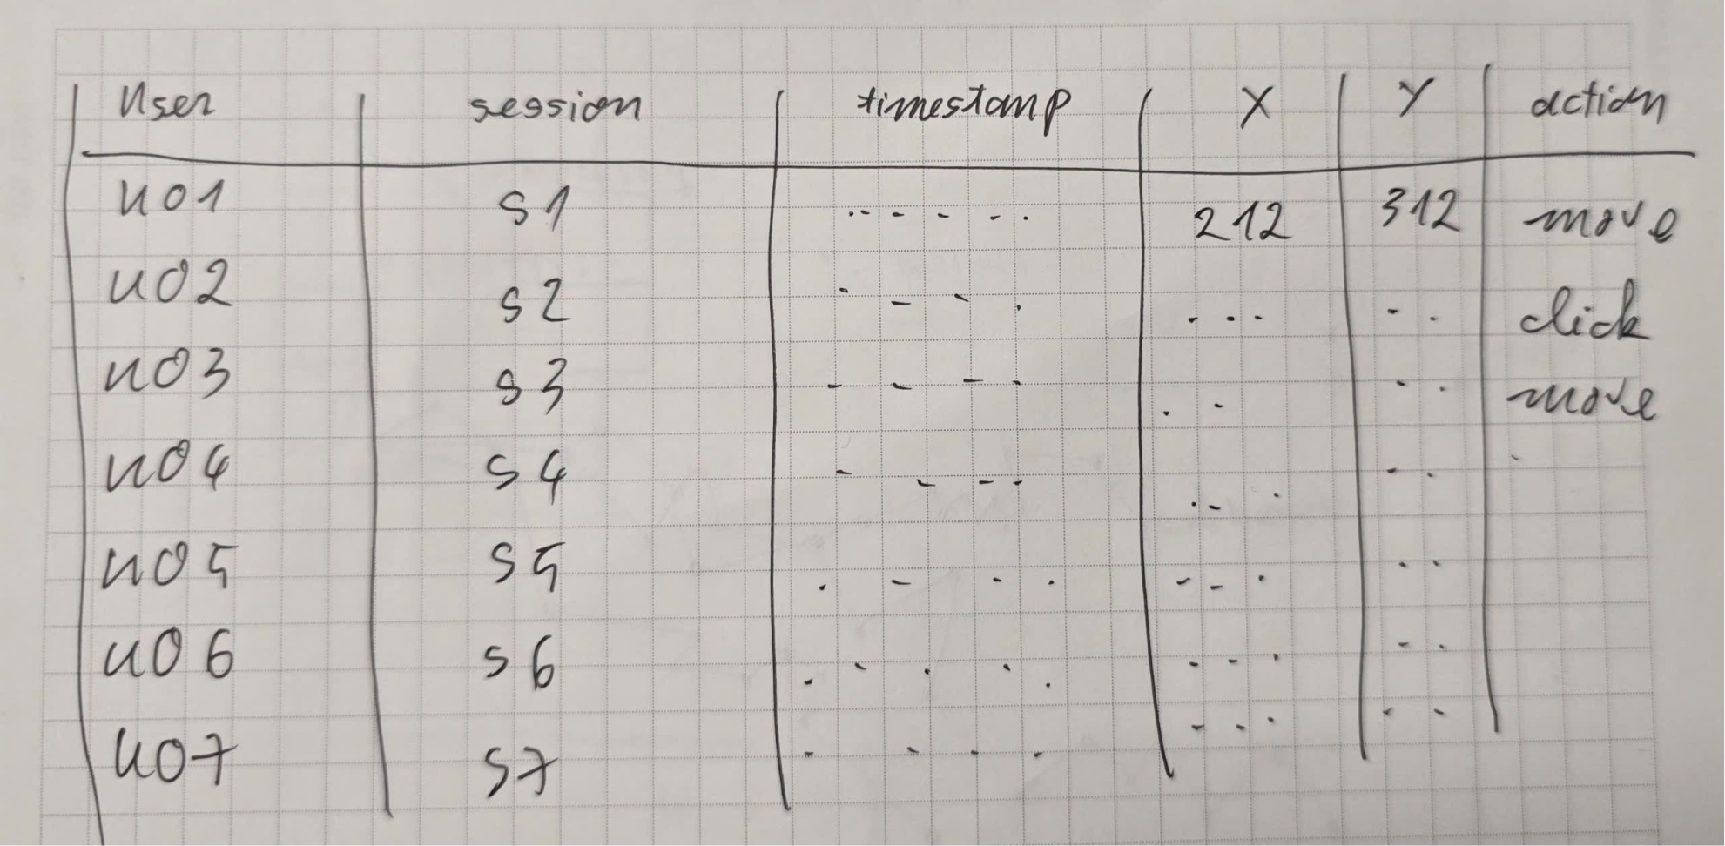
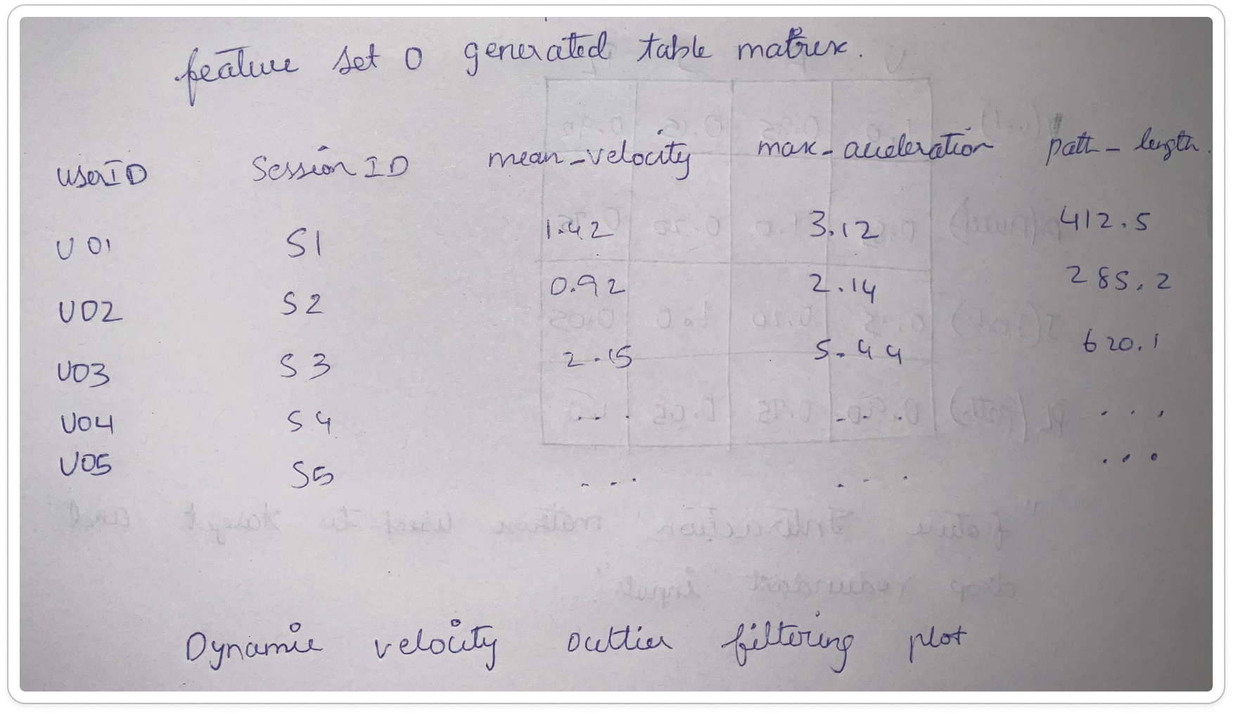
Sprint Pilot 1
Low Fidelity Prototypes
Scrum Retrospective
Lack of clear understanding of goals led to plan revisions
Lack of accountability and insufficient time allocation
Inefficient communication and separate expectations

Slide 9
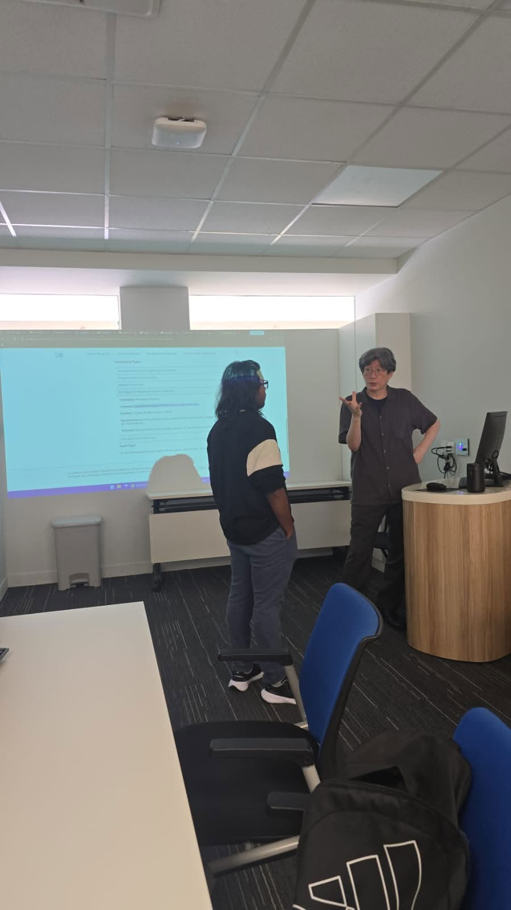
Client Feedback
📋
Clearer Information
Legends
Labels
Purpose of Charts
📚
Research Papers
Supporting literature
Academic references

Slide 10
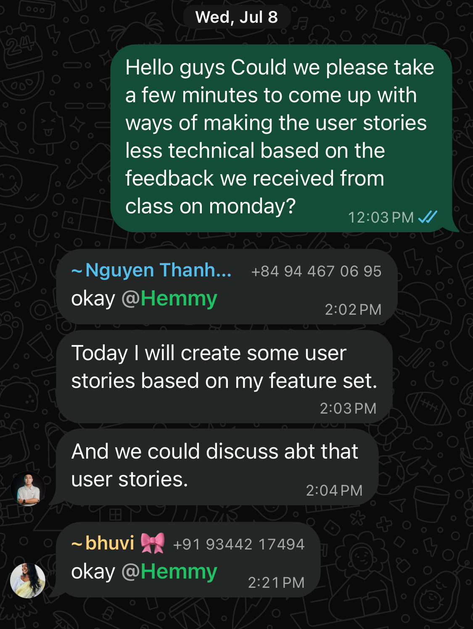
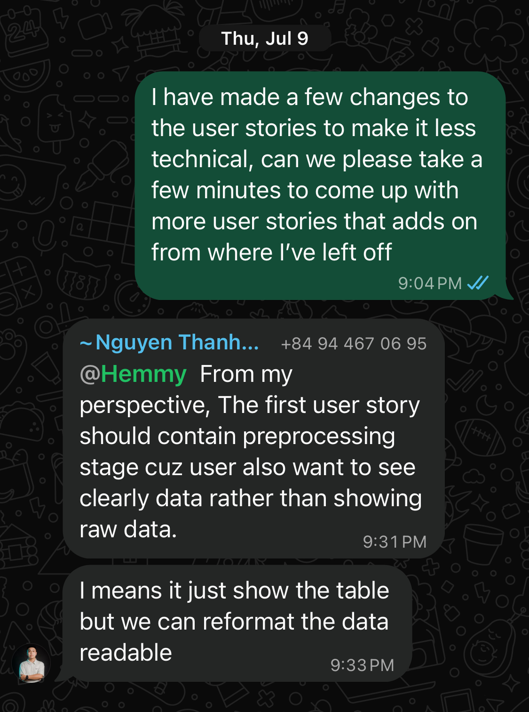
Sprint Pilot 2
Daily Scrums
Scrum Retrospective
Lagging behind on objectives, work carried into next sprint
Inefficient communication continued from previous sprint
Lack of implementation of client feedback

Slide 11
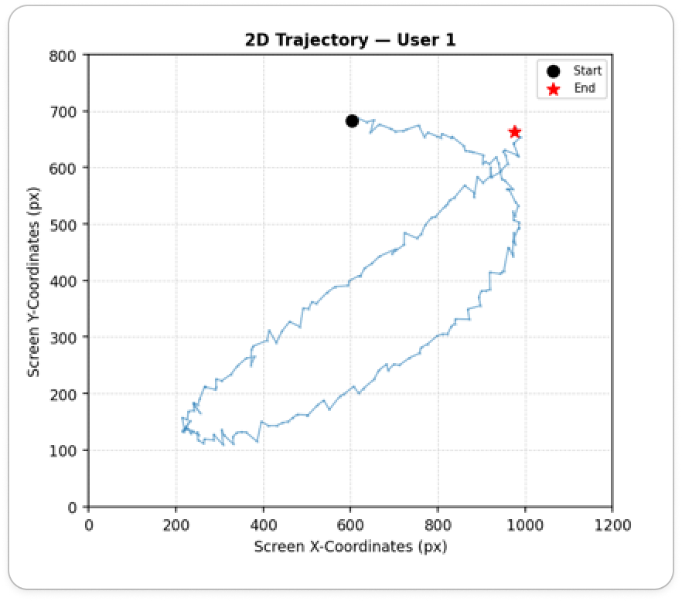
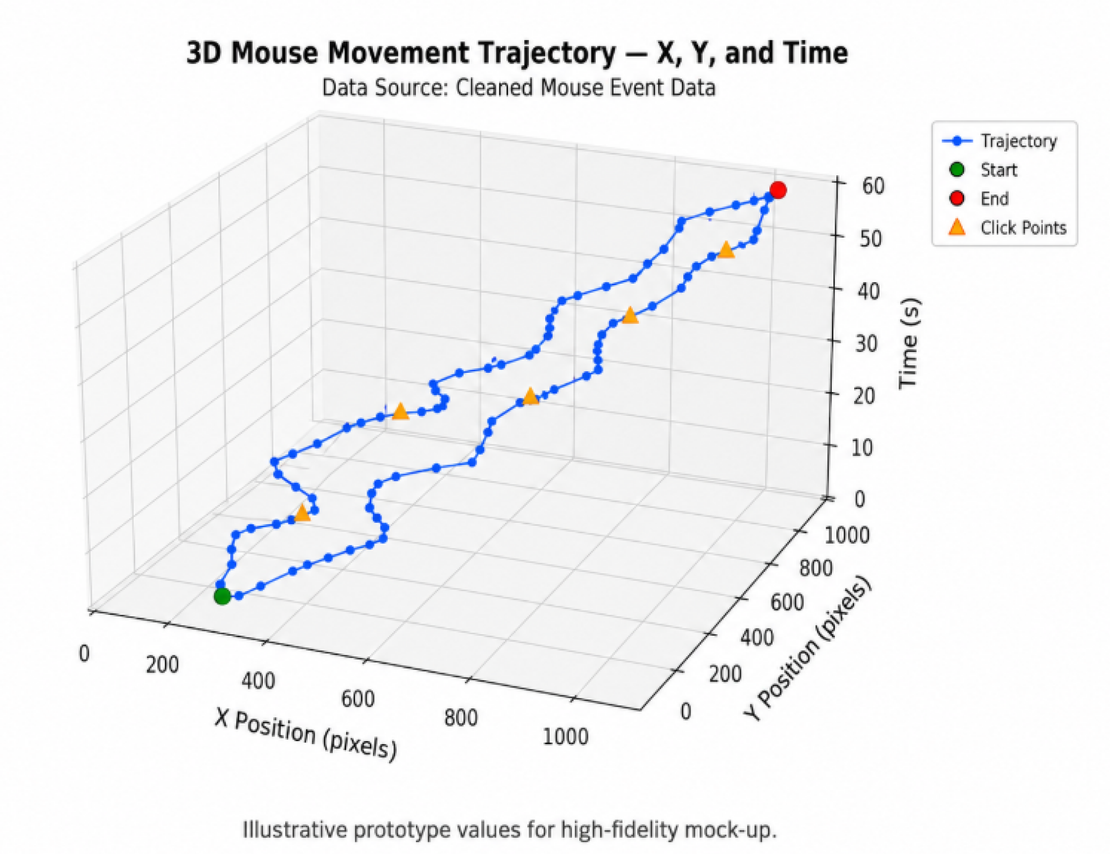
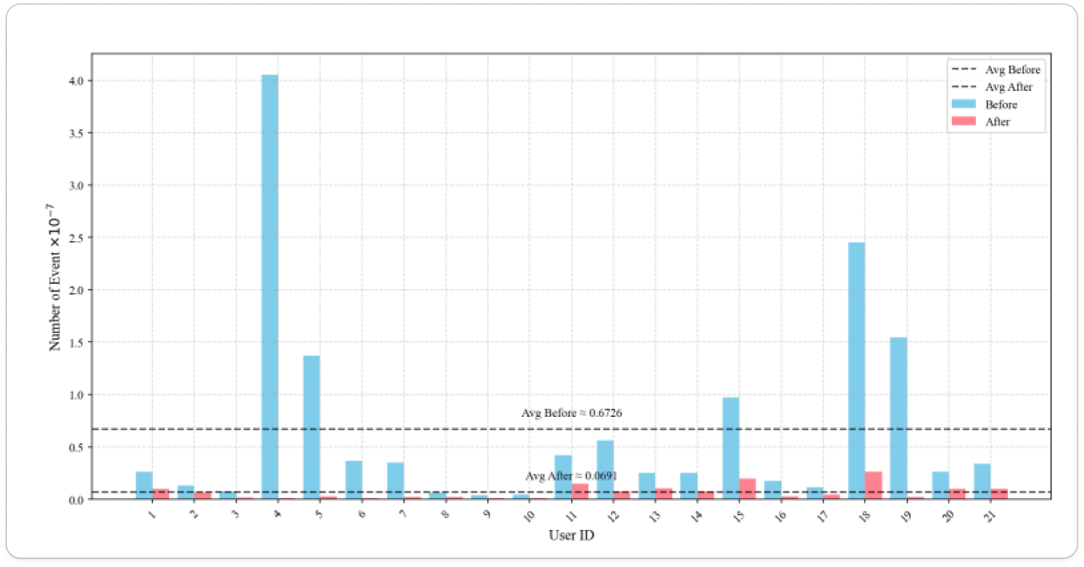
Sprint Pilot 3
High Fidelity
Scrum Retrospective
Sprint goals not specific enough — team worked in different directions
Client feedback not consistently reaching all team members
Individual work not shared early enough for mid-sprint feedback

Slide 12
Challenges
Impact of Team Diversity on Project Delivery
Diverse Team
→
Different Backgrounds
→
Different Expectations
→
No Shared Vision
→
Longer Deadlines
→
Lack of Quality
Diverse backgrounds strengthened technical perspectives but required additional coordination effort

Slide 13
Project Outcome
3 Feature Selection Algorithms
ExtraTreesClassifier
SelectKBest
Recursive Feature
Elimination
93%
88%
94%
Accuracy
Accuracy
Accuracy
Consistent Top 20 Features identified across all three algorithms
Consistent Machine Learning Algorithm Model — Random Forest Classifier

Slide 14
Conclusion
Status
Moving Forward
✅
Successful in Analysis
📋
Stricter Policies
⚠️
Difficulty with team co-ordination
🤝
Better Team Dynamics
Google Colab Project : https://colab.research.google.com/drive/1XO4Zbx4cWiJHJbDCARcp0VU_lAN73c7t?usp=sharing

